Slide 1

SRM INSTITUTE OF SCIENCE AND TECHNOLOGY Ramapuram Campus , Chennai – 600 089 DEPARTMENT OF COMPUTER SCIENCE AND ENGINEERING
18CSP103L- SEMINAR
IMPLEMENTATION OF NAS USING RAID
BATCH NUMBER : 2
Team Members | Supervisor
RA2111003020205 (Balaji Pandi) RA2111003020209 (Santhosh) RA2111003020190 (Abdul Samad) | NAME:

Slide 2
Agenda
Abstract
Scope and Motivation
Introduction
Literature Survey ( Table)
Objective
Problem Statement
Proposed Work
Architecture Diagram/Flow Diagram/Block Diagram
Novel idea
Modules
Module Description
Software & Hardware Requirements
Conclusion
References

Slide 3
ABSTRACT
This paper is a work on completely backing up disk files on client server/cloud drives
The current solution for home or small businesses to acquire extra storage is through online cloud services and solutions from the likes of big tech giants
While this is the simplest method, it is not the most efficient or cost effective

Slide 4
This is where the concept of NAS solution (Network Attached Storage) proves to be a viable and advantageous alternative.
NAS (Network-attached storage) is a data storage, which is connected to a computer network.
NAS acts a file server in a network, offering data storage to be located in a stand-alone network, which client computers can be connected

Slide 5
Scope and Motivation
The purpose of network-attached storage is to enable users to collaborate and share data more effectively. The scope of NAS storage is growing at a high rate with the emerging new technologies that are developed.

Slide 6
Accessibility :
NAS are most used and preferred mainly for their ease of access over Ethernet.
2. Cost-effectiveness:
NAS storage can be a cost-effective way to store data. This is because NAS servers are typically less expensive than traditional SAN
3. Collaboration:
NAS storage can be used to collaborate on projects with others on a network. This can be useful for businesses, schools, and other organizations

Slide 7
4. Backup and disaster recovery:
NAS storage can be used to backup data from computers and other devices. This can help to protect data from loss or corruption in the event of a disaster
5. File sharing:
NAS storage can be used to share files between users on a network.
6. Data archiving:
NAS storage can be used to archive data that is no longer needed on a regular basis. This can help to free up space on computers and other devices.

Slide 8
Introduction
Fundamentally, a NAS is a computer, optimized in hardware and software to be a file server. Data is a critical asset for company. Without access to their data, companies may not provide their expected level of service
NAS (Network-attached storage) is a data storage, which is connected to a computer network. NAS can be seen as a computer drive (via Ethernet) and as such, it can be used to save documents and files and as well as read them.

Slide 9
NAS provides both storage and a file system. This is often contrasted with SAN (storage area network), which provides only block-based storage and leaves file system concerns on the "client" side.
The key difference between direct-attached storage (DAS) and NAS is that DAS is simply an extension to an existing server and is not necessarily networked.
Both DAS and NAS can potentially increase availability of data by using RAID or clustering

Slide 10
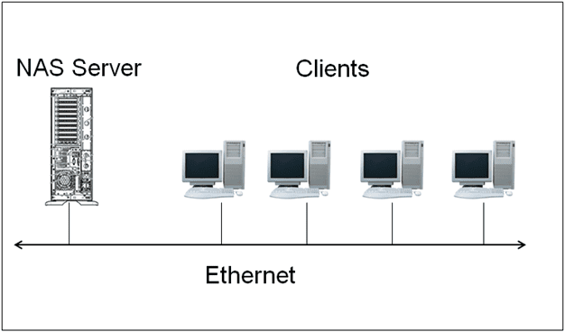
As the name suggests, DAS typically is connected via a USB or Thunderbolt enabled cable. NAS is designed as an easy and self-contained solution for sharing files over the network.

Slide 11
Literature Survey
S.No. | Title of the Paper | Year | Journal/Conference Name | Inferences
1. 2. | Network-Attached Storage: Data Storage Applications Network-attached Storage For Small Companies | 2021 2012 | Turkish Journal of Computer and Mathematics Education Design Foundation Finland ,Business Information Technology ,Bachelor Thesis Autumn | This research covers a very broad spectrum of the NAS technology and does not go into the implementation side well. This Research focusses on a very specific model of a NAS which is best suited for their foundation only.

Slide 12
Literature Survey
S.No. | Title of the Paper | Year | Journal/Conference Name | Inferences
3. 4. | Cloud computing: implementing nas in directing digital images without local storage Harnessing RAID mechanism for enhancement of data storage and security on cloud | 2013 2016 | Proceedings of International Conference Brazillian Journal of science and technology | This research paper talks only about manipulating digital images which is different from general use. focuses on the Cloud storage aspect of the NAS implementation.

Slide 13
Literature Survey
S.No. | Title of the Paper | Year | Journal/Conference Name | Inferences
5. | Network-Attached Storage: Architecture communications of the ACM | 2000 | Siros Technologies, San Jose, Canada | This research is outdated as many advancements have been made to the approach of implementing NAS effectively and easily.

Slide 14
Objective
The aim of this research is to create a data storage system for the case company which utilizes and fulfills the following requirements:
Data backups
External access over Internet
Access from LAN
Optimized data security
Maintainability
Future expansions

Slide 15
System health monitoring
Personal server grade applications
Smart security systems
Personal cloud server

Slide 16
Problem Statement
The current scenario for the people with aspiring small businesses and startups is the requirement of a centralized storage for their files and data.
However, traditional storage solutions like using multiple external hard drives, USB sticks and sometimes temporary subscription services. This generates a threat of a data loss in multiple ways
This can be very unreliable and slow for business use, which will lead to unorganized structure of storage with inefficiency.

Slide 17
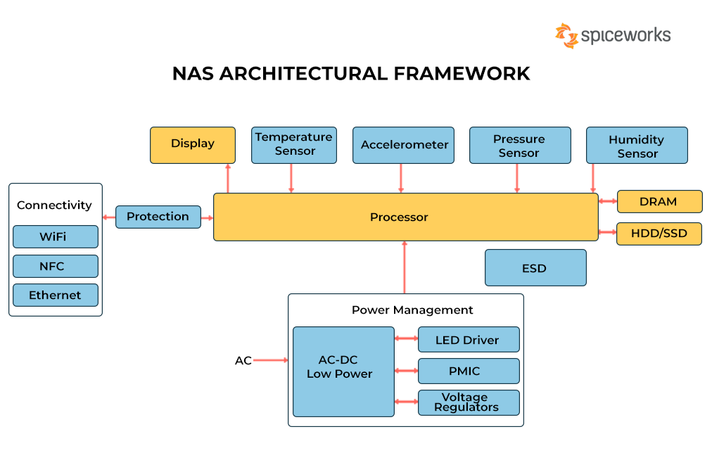
Proposed Work
Architecture Diagram:

Slide 18
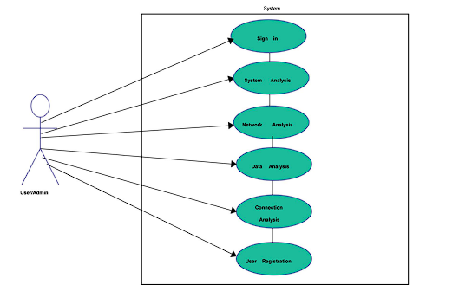
Use-Case Diagram

Slide 19
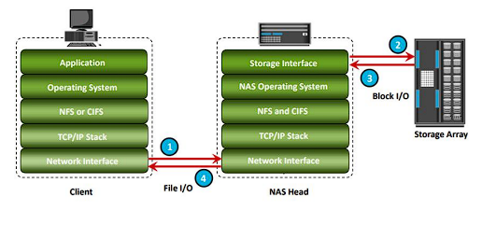
Data Flow Diagram

Slide 20
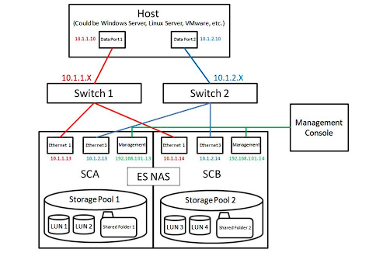
Deployment Diagram

Slide 21
Novel Idea:
The novel idea behind the implementation of NAS storage with RAID is to combine the advantages of both technologies to create a highly scalable, reliable, and performant storage solution.
Here are some specific examples of how NAS and RAID can be combined to create novel storage solutions:

Slide 22
Hybrid cloud NAS: NAS devices can be used to create a hybrid cloud storage solution by replicating data to a cloud storage service such as AWS S3 or Google Cloud Storage. This provides the scalability and reliability of cloud storage with the performance and convenience of on-premises NAS storage.
All-flash NAS: NAS devices can be configured with all-flash storage to achieve high performance and low latency. RAID can be used to improve the reliability of all-flash NAS arrays by providing redundancy.
Software-defined NAS: Software-defined NAS (SDNAS) solutions allow you to create a NAS storage system using commodity hardware. RAID can be used to create redundant storage pools for SDNAS solutions.

Slide 23
Modules:
NAS storage with RAID typically implements the following modules:
Storage management module: This module is responsible for managing the physical drives and RAID arrays in the NAS device. It also provides features such as volume provisioning, snapshots, and replication.
Storage Drives: These are the hard drives or solid-state drives that provide the storage capacity for a NAS unit. As more data storage is needed, additional hard disks can be added to meet the system demand
File system module: This module provides the file system that is used to store and access data on the NAS device. Common file systems used in NAS devices include NTFS, ext4, and Btrfs.

Slide 24
Modules
Networking module: This module provides the networking capabilities of the NAS device. It allows clients to connect to the NAS device and access its files over a network.
Security module: This module provides security features such as user authentication, authorization, and encryption. It helps to protect the NAS device and its data from unauthorized access.
RAID (Redundant Array of Independent Disks): NAS devices often use RAID technology to increase the performance and/or reliability of data storage. The RAID level used can vary depending on the specific needs and goals of the storage system

Slide 25
In addition to these core modules, NAS storage with RAID may also implement other modules such as:
Cloud storage module: This module allows the NAS device to replicate data to a cloud storage service.
Virtualization module: This module allows the NAS device to host virtual machines.
Backup module: This module provides backup and restore functionality for the NAS device.
Media streaming module: This module allows the NAS device to stream media files to clients.
The specific modules that are implemented in NAS storage with RAID will vary depending on the specific NAS device and its model.

Slide 26
Here are some examples of how these modules are used in NAS storage with RAID:
The storage management module can be used to create a RAID array by combining multiple physical drives into a single logical unit. This provides redundancy and improves performance.
The file system module can be used to create and manage volumes on the NAS device. Volumes are logical containers for data that are similar to partitions on a hard drive.
The networking module can be used to configure the NAS device's network settings and connect it to a network. This allows clients to access the NAS device's files over the network.
The security module can be used to create user accounts and assign permissions to files and folders. This helps to protect the NAS device and its data from unauthorized access.

Slide 27
RAID Levels
RAID 0
RAID 0 (also known as a stripe set or striped volume) splits (“stripes”) data evenly across two or more disks, without parity information, redundancy, or fault tolerance. Since RAID 0 provides no fault tolerance or redundancy, the failure of one drive will cause the entire array to fail; as a result of having data striped across all disks, the failure will result in total data loss.
RAID 1
RAID 1 consists of an exact copy (or mirror) of a set of data on two or more disks; a classic RAID 1 mirrored pair contains two disks. This configuration offers no parity, striping of disk space across multiple disks since the data is mirrored on all disks belonging to the array.

Slide 28
RAID Levels
RAID 5
RAID 5 consists of block-level striping with distributed parity. Parity information is distributed among the drives. It requires that all drives but one be present to operate. Upon failure of a single drive, subsequent reads can be calculated from the distributed parity such that no data is lost. RAID 5 requires at least three disks.
Raid 6
RAID 6 extends RAID 5 by adding another parity block. It uses block-level striping with two parity blocks distributed across all member disks. As in RAID 5 there are many layouts of RAID 6 disk arrays depending upon the direction the data blocks are written, the location of the parity blocks with respect to the data blocks, and whether or not the first data block of a subsequent stripe is written to the same drive as the last parity block of the prior stripe.

Slide 29
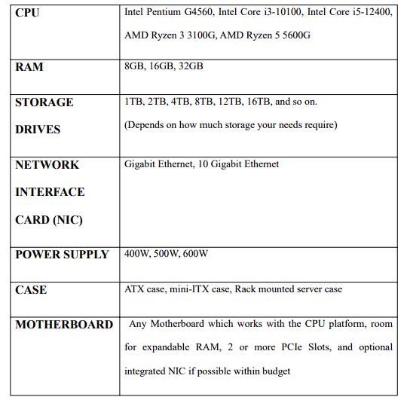
Software & Hardware Requirements
Hardware Components

Slide 30
Software Components
Open-source software’s main idea is that its source code is free and, in this context, it means that it is open, public and non-proprietary. As the business needs to operate within a specific budget, there’s not much room for extra cost
It is also vital to understand that in some use scenarios the better choice, as an OS, would be Microsoft Windows Server. However, in this implementation there were no specific requirements which would have required Windows
1. TrueNAS Scale
2. OpenMediaVault (OMV)

Slide 31
TrueNAS
TrueNAS Scale is a free and open-source NAS operating system based on Debian Linux and the ZFS file system. It is a scale-out NAS solution that can be used to build clusters of NAS servers with capacities of up to hundreds of petabytes.

Slide 32
OpenMediavault
OpenMediaVault (OMV) is also a free and open-source NAS operating system based on Debian Linux. It is a simple and easy-to-use solution that allows users to set up and manage a NAS system without having to have any prior Linux experience

Slide 33
Why Choose TrueNAS
OpenZFS has supported Linux well. The issue tends to be that most Linux distributions don't include OpenZFS by default. TrueNAS SCALE changes this around by making OpenZFS the default file system and supporting it via APIs and WebUI.
The power consumption and performance of SCALE seems to be very similar to CORE.
It also has a more understandable and a rather intuitive, yet comprehensive user
interface for set up and management utility. Any user who is looking to get into building their first NAS or an existing user, can feel at ease while trying to use TrueNAS Scale

Slide 34
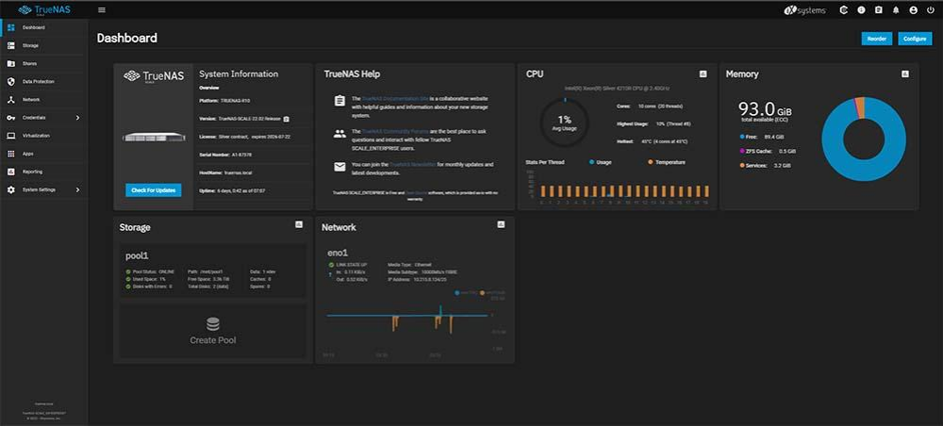
Conclusion Screenshots

Slide 35
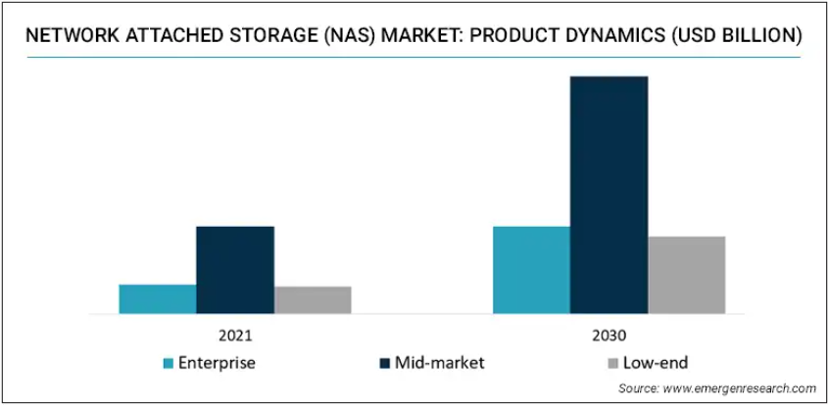
Conclusion Graphs

Slide 36
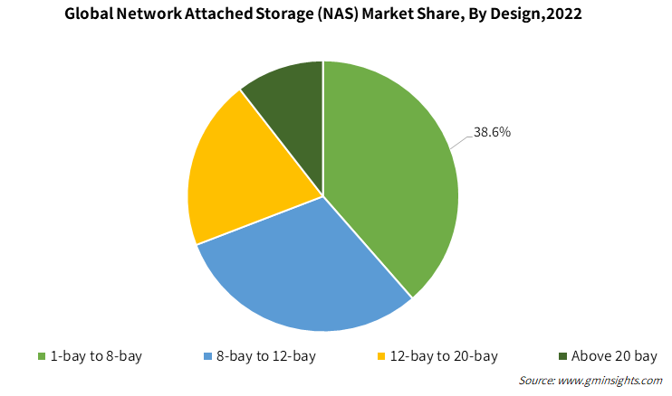
Conclusion Graphs

Slide 37
Conclusion Reliability and Validity
Reliability means a statistical measurement of data about how reproducible it is. Since this research only created one type of NAS system with some alternative options for certain components and requirements, it is important to note that the reliability of the system is unknown.
The validity in this research is confirmed by re searching the findings in literature and by comparing the findings between the results in this study and the findings in literature

Slide 38
Conclusion Future Studies
This study discusses implementations which work on small scaled NAS or home-environment applications.
However, with a higher price tag, there are also NAS-devices which are usually rack mountable and decently fault-tolerant.
It would be a good idea to conduct a further study about the differences between pure NAS-devices and servers like in this resear

Slide 39
References
1. Network-Attached Storage For Small Companies ,Case: Design Foundation Finland ,Business Information Technology ,Bachelor Thesis Autumn 2012 ,Jari-Pekka Koivisto
2. Network-Attached Storage: Data Storage Applications ,Turkish Journal of Computer and Mathematics Education, V ol.12 No.12 (2021), 2385-2396 Research Article, Ravi Kumar M G, Ayudh Nagaraj, Benjamin Paul, Sharat P Dixit.
3. Cloud computing: implementing nas in directing digital images without local storage, Proceedings of International Conference “ICSEM’13”, J.C. Rosaline Christi, R. Illakia , M.Gowri

Slide 40
References
4. Harnessing RAID mechanism for enhancement of data storage and security on cloud, Sudipta Sahana, Rajesh Bose and Debabrata Sarddar, Brazillian Journal of science and technology
5. Network Attached Storage Architecture, Communications Of The ACM November 2000/Vol. 43, No. 11, Garth A. Gibson and Rodney Van Meter.
6. Dataplexed Network Attached Storage System, Volume : 3, Issue : 2, February 2014. Praveen Vijai, Minnu Meria, Midhu Babu.
7. NAS (Network Attached Storage), International Research Journal of Engineering and Technology (IRJET), Volume: 07 Issue: 04 | Apr 2020, Siddh Mistry, Janki Prajapati, Mohini Patel, Ms. Swati. S. Saxena.

Slide 41
References
8. Hitachi NAS Storage for Unstructured Data, Silverton Consulting, Inc. StorInt
Briefing, 2021.
9. Dell Unity: NAS Capabilities, Dell Technologies, April 2022.
10. NAS or iSCSI? Selecting a storage system, White Paper 2006, Open-E.

